Slide 1

Vehicle Rental Management database design and Implementation

Slide 2


Team Members
Shashank Rao Gujja
Srikumar Dundigalla
Penchala Akshay Kumar Kandagaddala
Venkata Sai Gagan Deep Alusuri
Naveen Yeluru
Meghana Rudraraju
Rohith Rasamalla
Vinay Kumar Moluguri

Slide 3


Agenda
Intro - About the Data
ER diagram
ER description
Data Intergrity
Database design
Data Visualization
Summary
Thank you

Slide 4




About the Data
This project is intended to be used by a car rental company that specializes in providing car rental services profitably. People can use this online database management system to browse available vehicles, assess their condition, register, contact the owners, and more set them aside.
The major purpose of the database is to keep track of all the vehicles that can be rented, including information on each owner, rental rates, specifics of each rental, and vehicles that are available at any given time.

Slide 5

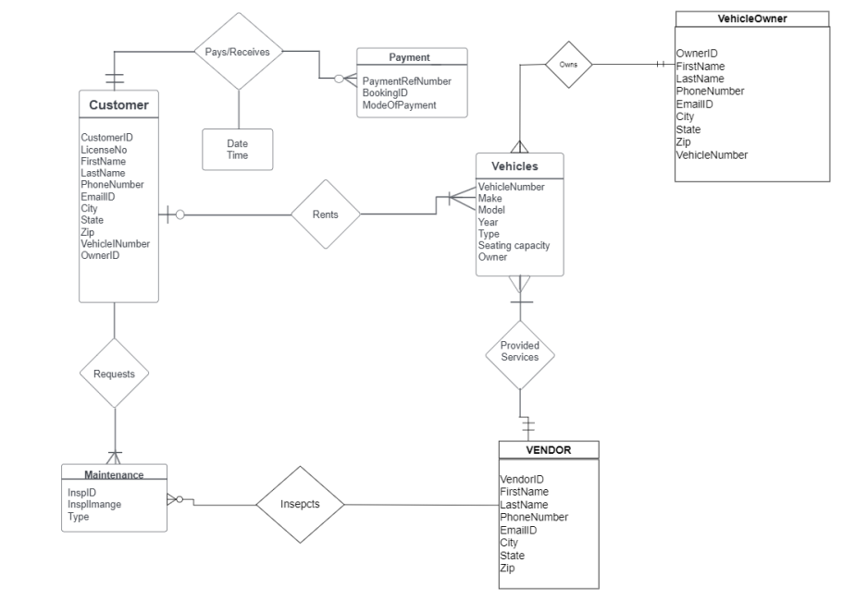
ER Diagram

Slide 6

ER description
An ER diagram is made from the above-mentioned entities with the following assumptions:
One person may own more than one car.
Depending on the vehicle's availability, one buyer may reserve numerous automobiles.
The vendor for maintenance may receive repeated requests from the owner.
A single client has the option to make numerous car maintenance-related complaints to the owner.

Slide 7
Data Integrity
Data integrity refers to the maintenance and consistency of data across the course of a database. Integrity constraints in tables are used to protect data integrity in databases. Business rules are applied to database tables by integrity constraints. Column-level limits and table-level restrictions are two different types of constraints.
NOT NULL - Ensures that a column cannot have a NULL value
PRIMARY KEY - A NOT NULL and UNIQUE combination. Identifies each table row in a unique way.
FOREIGN KEY - Guards against acts that would break linkages between tables.
CREATE INDEX - Used to easily create and access data from the database.

Slide 8
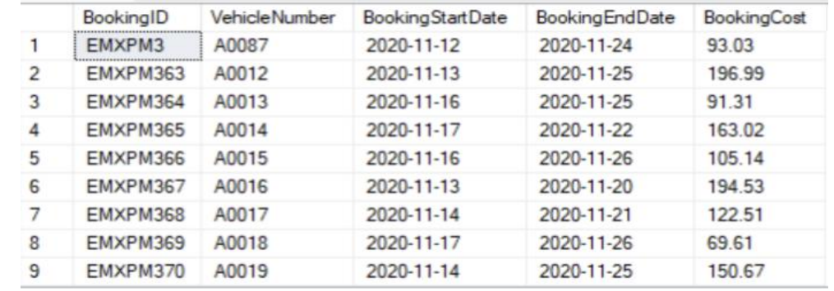
Database Design
Following is a snapshot of the Booking Information that is stored in the database

Slide 9
Data Visualization

Slide 10

Summary
We have mainly focused on building a database for a car rental company. We will be handling a wide range of diverse elements. A few of the components include car owners, car types, rental information, customer databases, etc.

Slide 11


Thank You

